Slide 1
Saving, Investment, and
the Financial System (Chapter 26)
Money, Growth and Inflation(chapter 30)

Slide 2
Financial Institutions
Financial system
  Group of institutions in the economy
    That help match one person’s saving with another person’s investment
  Moves the economy’s scarce resources from savers to borrowers
Financial institutions
  Financial markets
  Financial intermediaries

Slide 3
Financial Markets, Part 1
Financial markets
  Savers can directly provide funds to borrowers
  The bond market
  The stock market

Slide 4
Financial Markets, Part 2
The bond market
  Bond: certificate of indebtedness
    Date of maturity, when the loan will be repaid
    Rate of interest, paid periodically until the date of maturity
    Principal, amount borrowed
  Borrowing from the public
    Used by large corporations, the federal government, or state and local governments

Slide 5
Financial Markets, Part 3
The bond market
  Term: length of time until maturity
    A few months, 30 years, perpetuity
    Long-term bonds are riskier than short-term bonds
      Long-term bonds usually pay higher interest rates

Slide 6
Financial Markets, Part 4
The bond market
  Credit risk: probability of default
    Probability that the borrower will fail to pay some of the interest or principal
    Higher interest rates for higher probability of default
    U.S. government bonds tend to pay low interest rates
    Junk bonds, very high interest rates
      Issued by financially shaky corporations

Slide 7
Financial Markets, Part 5
The bond market
  Tax treatment
    Interest on most bonds is taxable income
    Municipal bonds
      Issued by state and local governments
      Owners are not required to pay federal income tax on the interest income
      Lower interest rate

Slide 8
Financial Markets, Part 6
The stock market
  Stock: claim to partial ownership in a firm
    A claim to the profits that a firm makes
  Organized stock exchanges
    Stock prices: demand and supply
  Equity finance
    Sale of stock to raise money
  Stock index
    Average of a group of stock prices

Slide 9
Financial Intermediaries, Part 1
Financial intermediaries
  Savers can indirectly provide funds to borrowers
  Banks
  Mutual funds

Slide 10
Financial Intermediaries, Part 2
Banks
  Take in deposits from savers
    Banks pay interest
  Make loans to borrowers
    Banks charge interest
  Facilitate purchasing of goods and services
    Checks: medium of exchange

Slide 11

Financial Intermediaries, Part 3
Mutual funds
  Institution that sells shares to the public
  Uses the proceeds to buy a portfolio of stocks and bonds
  Advantages
      Diversification; professional money managers

Slide 12
National Income Accounts
Rules of national income accounting
  Important identities
Identity
  An equation that must be true because of the way the variables in the equation are defined
  Clarify how different variables are related to one another

Slide 13
Accounting Identities, Part 1
Gross domestic product (GDP)
  Total income
  Total expenditure
Y = C + I + G + NX
  Y = gross domestic product, GDP
  C = consumption
  I = investment
  G = government purchases
  NX = net exports

Slide 14
Accounting Identities, Part 2
Closed economy
  Doesn’t interact with other economies
  NX = 0
Open economy
  Interact with other economies
  NX ≠ 0

Slide 15
Accounting Identities, Part 3
Assume closed economy: NX = 0
  Y = C + I + G
National saving (saving), S
  Total income in the economy that remains after paying for consumption and government purchases
  Y – C – G = I
  S = Y – C – G
  S = I

Slide 16
Accounting Identities, Part 4
T = taxes minus transfer payments
  S = Y – C – G
  S = (Y – T – C) + (T – G)
Private saving, Y – T – C
  Income that households have left after paying for taxes and consumption
Public saving, T – G
  Tax revenue that the government has left after paying for its spending

Slide 17
Accounting Identities, Part 5
Budget surplus: T – G > 0
  Excess of tax revenue over government spending
Budget deficit: T – G < 0
  Shortfall of tax revenue from government spending

Slide 18
Saving and Investing
Accounting identity: S = I
Saving = Investment
  For the economy as a whole
  One person’s savings can finance another person’s investment

Slide 19
The Market for Loanable Funds, Part 1
Market for loanable funds
  Market
    Those who want to save supply funds
    Those who want to borrow to invest demand funds
  One interest rate
    Return to saving
    Cost of borrowing
  Assumption
    Single financial market

Slide 20
The Market for Loanable Funds, Part 2
Supply and demand of loanable funds
  Source of the supply of loanable funds
    Saving
  Source of the demand for loanable funds
    Investment
  Price of a loan = real interest rate
    Borrowers pay for a loan
    Lenders receive on their saving

Slide 21
The Market for Loanable Funds, Part 3
Supply and demand of loanable funds
  As interest rate rises
    Quantity demanded declines
    Quantity supplied increases
  Demand curve
    Slopes downward
  Supply curve
    Slopes upward

Slide 22
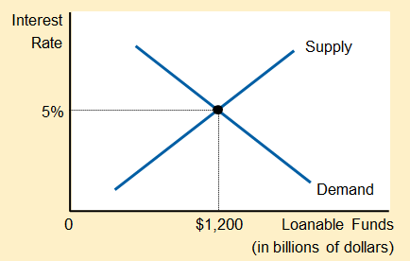
Figure 1
The Market for Loanable Funds
The interest rate in the economy adjusts to balance the supply and demand for loanable funds. The supply of loanable funds comes from national saving, including both private saving and public saving. The demand for loanable funds comes from firms and households that want to borrow for purposes of investment. Here the equilibrium interest rate is 5 percent, and $1,200 billion of loanable funds are supplied and demanded.

Slide 23
The Market for Loanable Funds, Part 4
Government policies
  Can affect the economy’s saving and investment
    Saving incentives
    Investment incentives
    Government budget deficits and surpluses

Slide 24
Policy 1: Saving Incentives
Shelter some saving from taxation(tax law that encourages savings: HH use this funding to buy more funds or increase their deposits in banks).
  Affect supply of loanable funds
  Increase in supply
    Supply curve shifts right
  New equilibrium
    Lower interest rate
    Higher quantity of loanable funds
      Greater investment

Slide 25
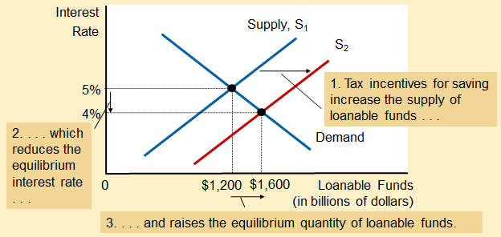
Figure 2
Saving Incentives Increase the Supply of Loanable Funds
A change in the tax laws to encourage Americans to save more would shift the supply of loanable funds to the right from S₁ to S₂. As a result, the equilibrium interest rate would fall, and the lower interest rate would stimulate investment. Here the equilibrium interest rate falls from 5 percent to 4 percent, and the equilibrium quantity of loanable funds saved and invested rises from $1,200 billion to $1,600 billion.

Slide 26
Policy 2: Investment Incentives
Investment tax credit(gives a tax advantage to any firms building a new factory or buying a new equipment)
  Affect demand for loanable funds (reward firms that borrow and invest in new capital)
  Increase in demand
    Demand curve shifts right
  New equilibrium
    Higher interest rate
    Higher quantity of loanable funds
      Greater saving

Slide 27
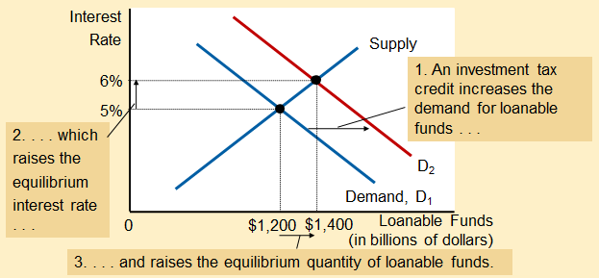
Figure 3
Investment Incentives Increase the Demand for Loanable Funds
If the passage of an investment tax credit encouraged firms to invest more, the demand for loanable funds would increase. As a result, the equilibrium interest rate would rise, and the higher interest rate would stimulate saving. Here, when the demand curve shifts from D₁ to D₂, the equilibrium interest rate rises from 5 percent to 6 percent, and the equilibrium quantity of loanable funds saved and invested rises from $1,200 billion to $1,400 billion.

Slide 28
Policy 3: Budget Deficit/Surplus, Part 1
Government - starts with balanced budget
  Then starts running a budget deficit
    Change in supply of loanable funds
    Decrease in supply
      Supply curve shifts left
    New equilibrium
      Higher interest rate
      Smaller quantity of loanable funds

Slide 29
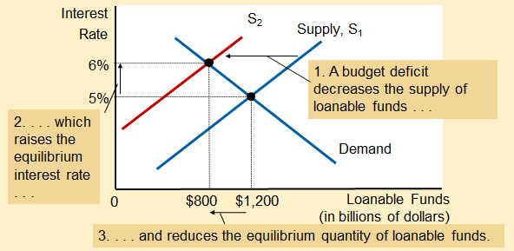
Figure 4
The Effect of a Government Budget Deficit
When the government spends more than it receives in tax revenue, the resulting budget deficit lowers national saving. The supply of loanable funds decreases, and the equilibrium interest rate rises. Thus, when the government borrows to finance its budget deficit, it crowds out households and firms (decrease inv because of govt borrowings) that otherwise would borrow to finance investment. Here, when the supply shifts from S₁ to S₂, the equilibrium interest rate rises from 5 to 6 percent, and the equilibrium quantity of loanable funds saved and invested falls from $1,200 billion to $800 billion.

Slide 30
Policy 3: Budget Deficit/Surplus, Part 2
Crowding out
  Decrease in investment
  Results from government borrowing
Government - budget deficit
  Interest rate rises
  Investment falls

Slide 31
Policy 3: Budget Deficit/Surplus, Part 3
Government – budget surplus
  Increase supply of loanable funds
  Reduce interest rate
  Stimulates investment

